Slide 1

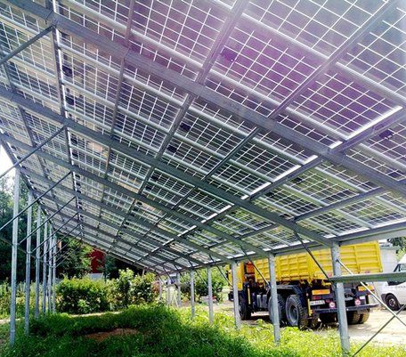


Sawsan Shukri, PhD Student
Nabila Elbeheiry, Research Assistant
5G Connected and Photovoltaic Powered Next Generation Greenhouses for Food Security [5GPPGH] – Sensor node

Slide 2
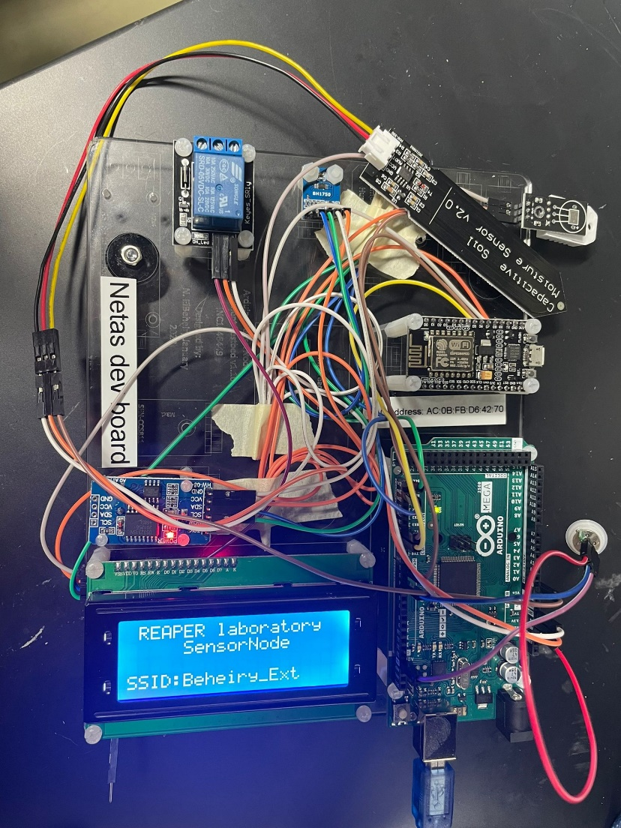
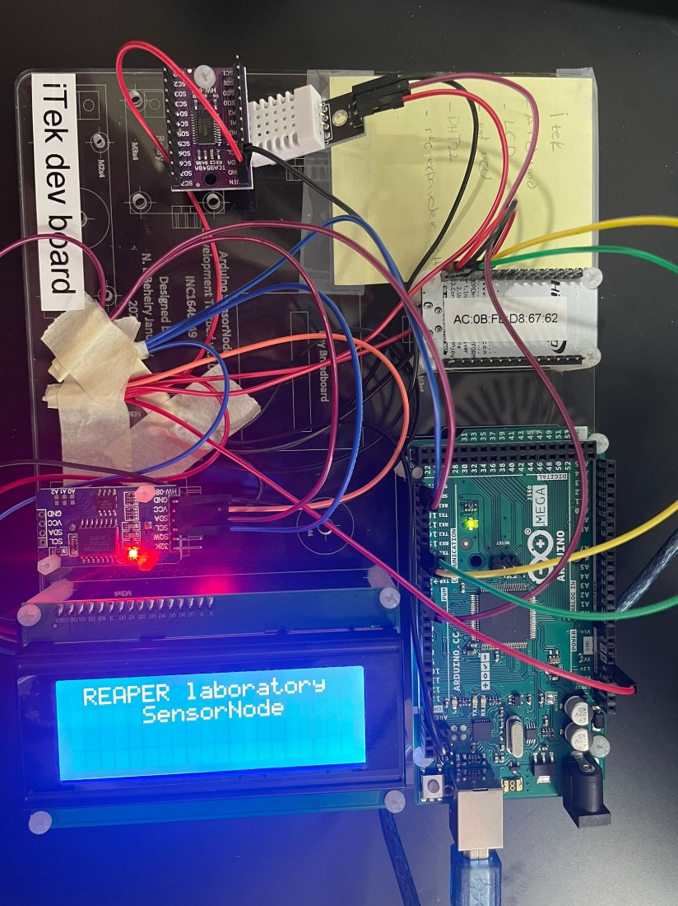
Pictures of the Sensor Node Development Testbed

Slide 3
How to use the firmware

Slide 4
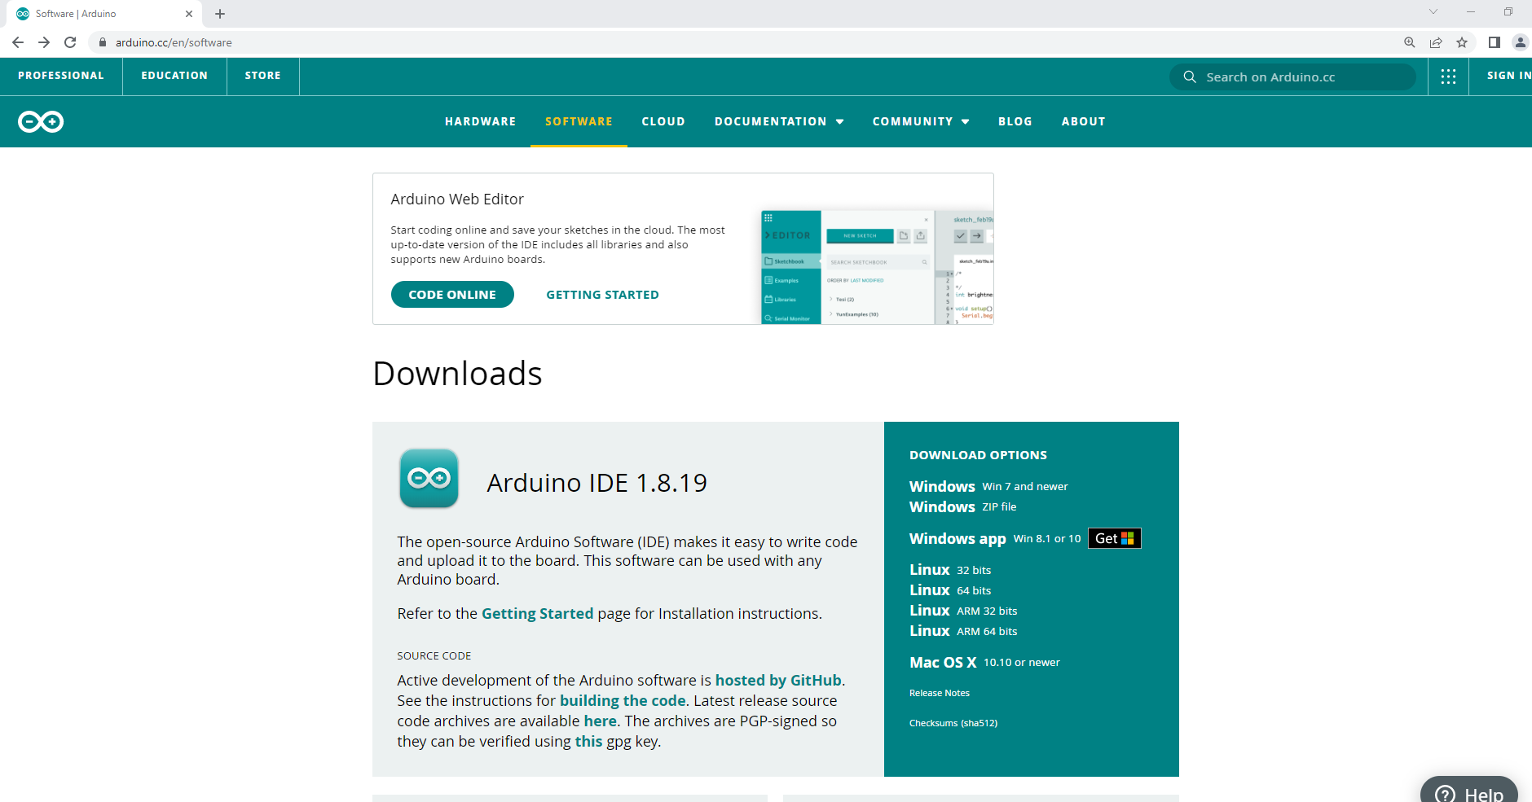
1- Install Arduino IDE
Go to https://www.arduino.cc/en/software
Under download options choose your operating system installer
Start downloading and installing the IDE

Slide 5
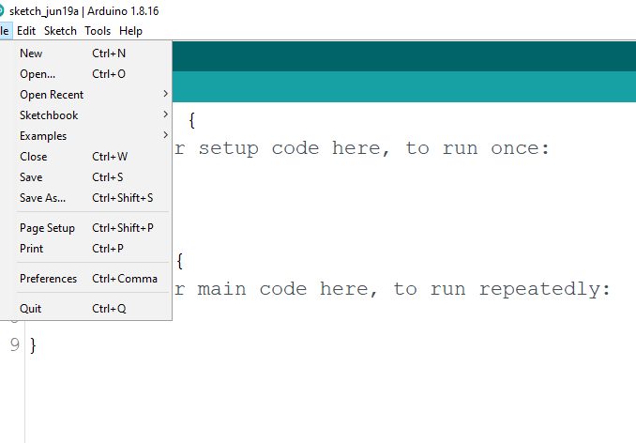
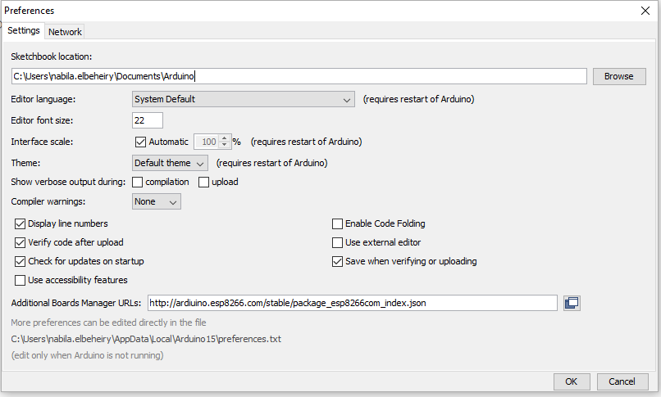
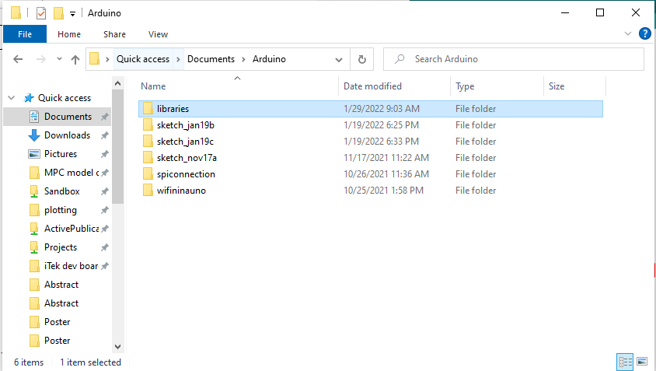
2- Put libraries in the default library folder
In the Arduino IDE, go to files, preferences and copy the default folder path
Paste the default folder path in your windows file explorer and go to libraries
Copy all the provided libraries and paste them in the default folder path
Default folder path

Slide 6
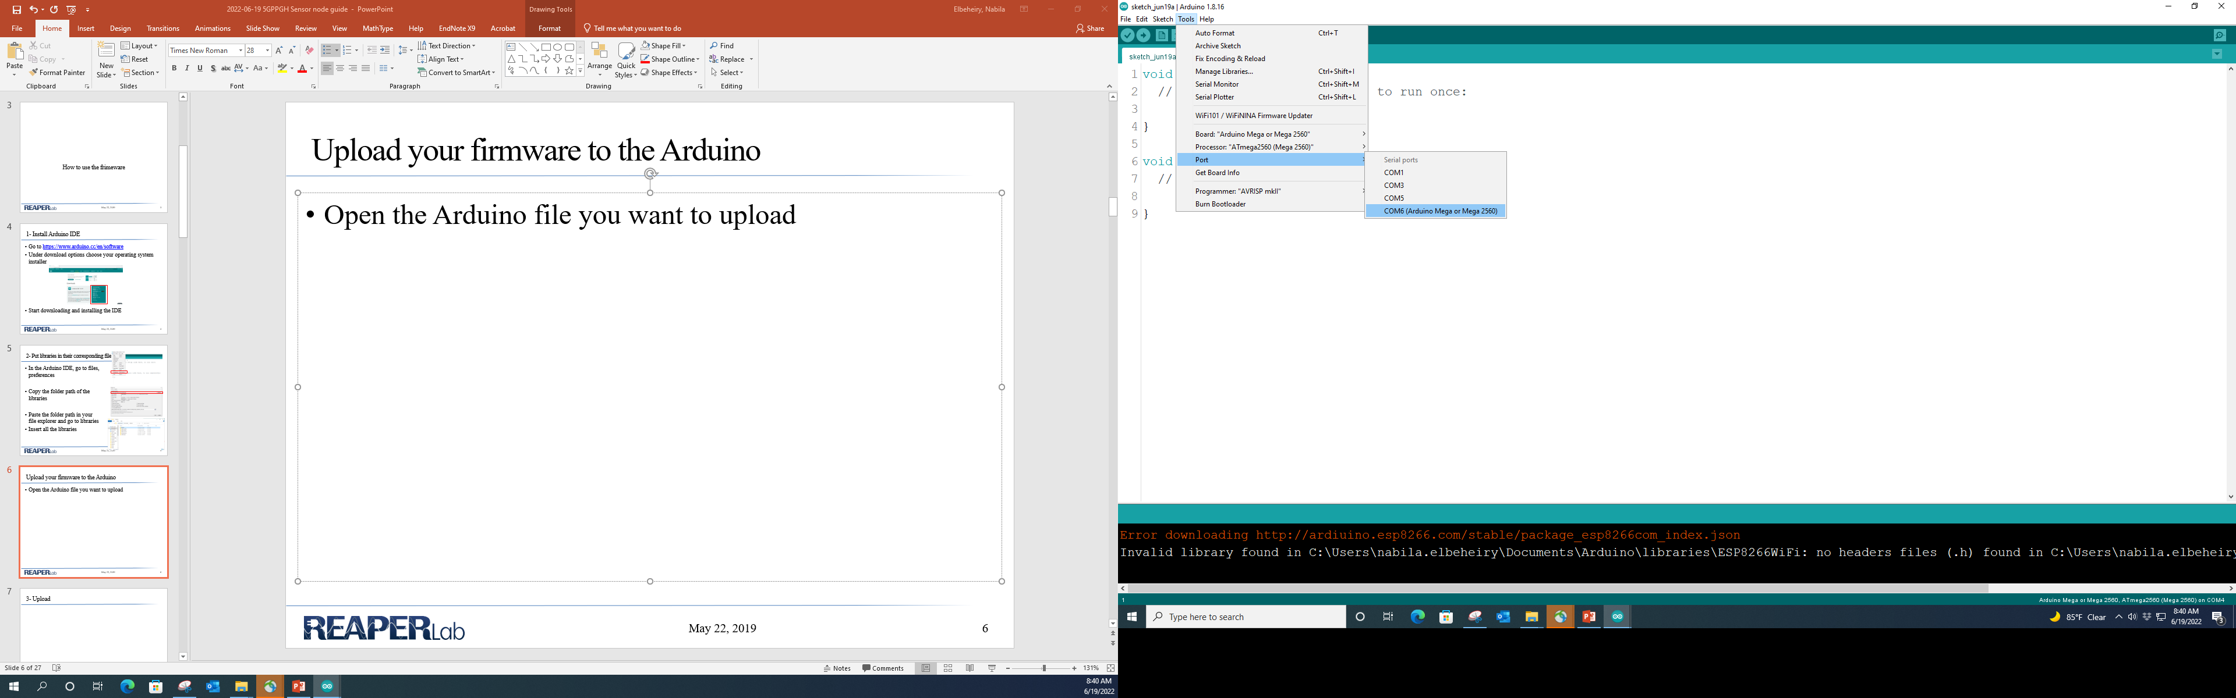
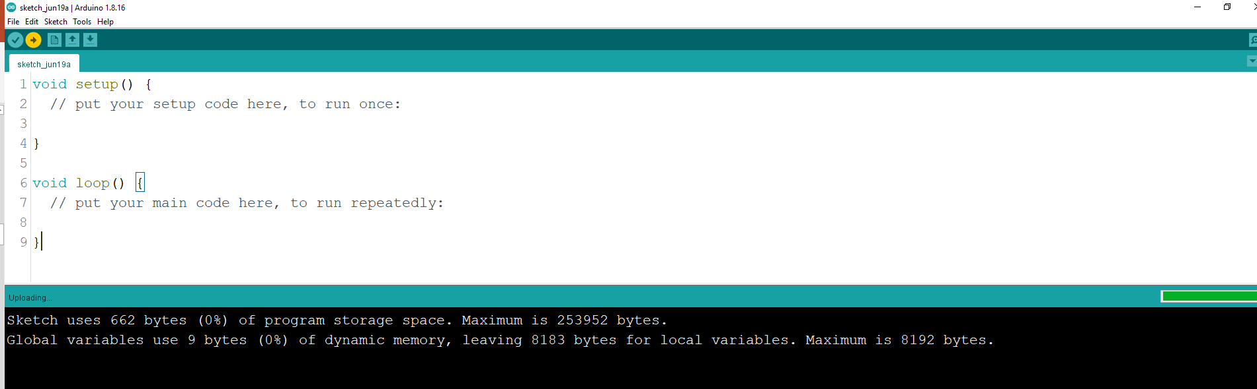
3-Upload firmware to the Arduino
Open the Arduino file you want
to upload
Under tools make sure board is selected as mMega2560 and the right communication port is selected
Press upload and observe your sketch being compiling and uploading to the system

Slide 7
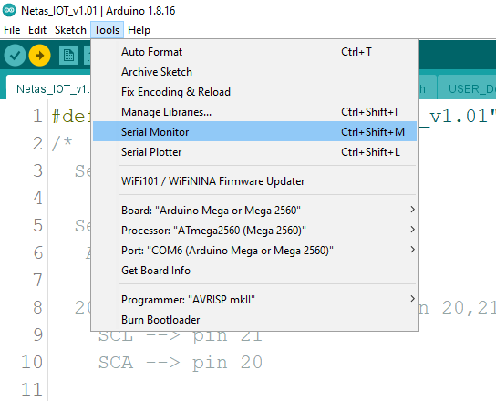
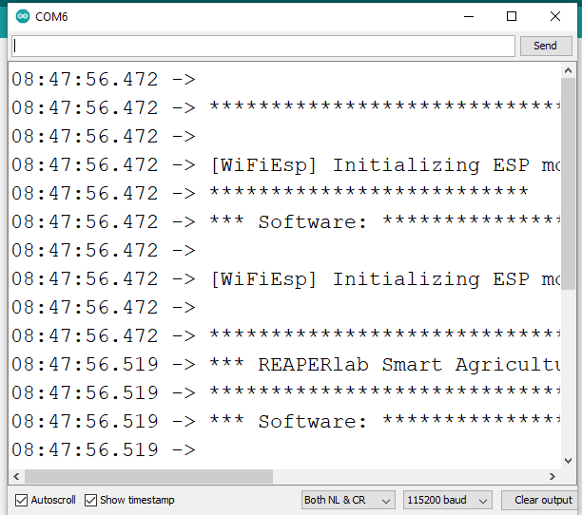
4-Monitor from the serial monitor
Under tools, choose serial monitor
In the serial monitor set the baud rate to 115200

Slide 8
IoT Interface
 | ThingSpeak Native |  | ThingSpeak JSON
 | Free version | Academic Subscription | Free version | Academic Subscription
Libraries | WiFiEsp.h and ThingSpeak.h |  | WiFiEsp.h
Message update interval limit | Every second | Every 15 seconds | Every second | Every 15 seconds
Others |  |  | Requires date/time stamp
Advantages | Optimized |  | Universal format (create payload data which is portable to other clouds)
Limitations | Built around ThingSpeak cloud |  | Huge Data size

Slide 10
Old Slides

Slide 11
Phases of Development
Phase 1 – Sensor Node Development Testbed
Uses off-the-shelf sensor modules instead of sensor chips
Develop function calls for each sensor module
Develop and test integration of multiple sensors with communication
Phase 2 – purpose-built Sensor Node for field testing
Custom-designed PCB with sensors chips
Custom-designed enclosure

Slide 12
Phase 1: Sensor Node Development Testbed
GOAL: rapid prototyping and testing of firmware and hardware integration
Sensors
Reads data from sensors (currently every 1 second)
Buffers data, transmits to cloud platform
LCD screen for diagnostics and debugging
Communication
WiFi communication using ESP8266 NodeMCU
Currently communicating with ThingSpeak™
ThingSpeak™ Arduino library
JSON format and HTTP post requests
Test a basic communication with NetasIon using JSON
Easy to modify existing firmware that uses JSON format

Slide 13
Functional Block Diagram

Slide 14
Sensor Node Module List
Arduino mega2560
LCD screen 4x20 characters
ESP8266 NodeMCU
Digital light intensity sensor, part number GY-302 BH1750
PIR sensor, part number AM312 HC-SR312
Capacitive soil moisture sensor V1.2
Resistive soil moisture sensor , HD-38
Co2 air quality gas sensor module, part number CCS811
Temperature and humidity sensor, part number DHT11
Real time clock, part number DS3231 AT24C32
RS485 to TTL board, part number SH-U12
Xinwoer soil NPK sensor V2.0
Xinwoer soil PH sensor V2.0

Slide 15
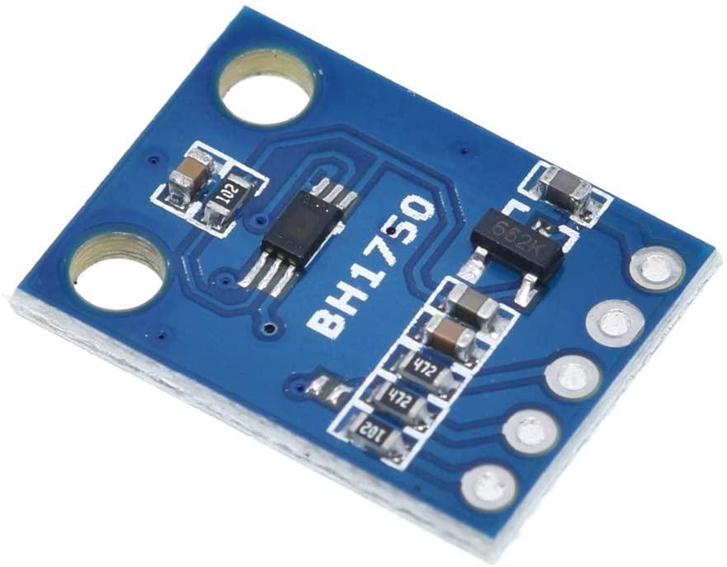
Sensor Development
Digital light intensity sensor
Supplied with 3.3 to 6V
I2C communication
I2C SCL Clock Frequency 400kHz

Slide 16
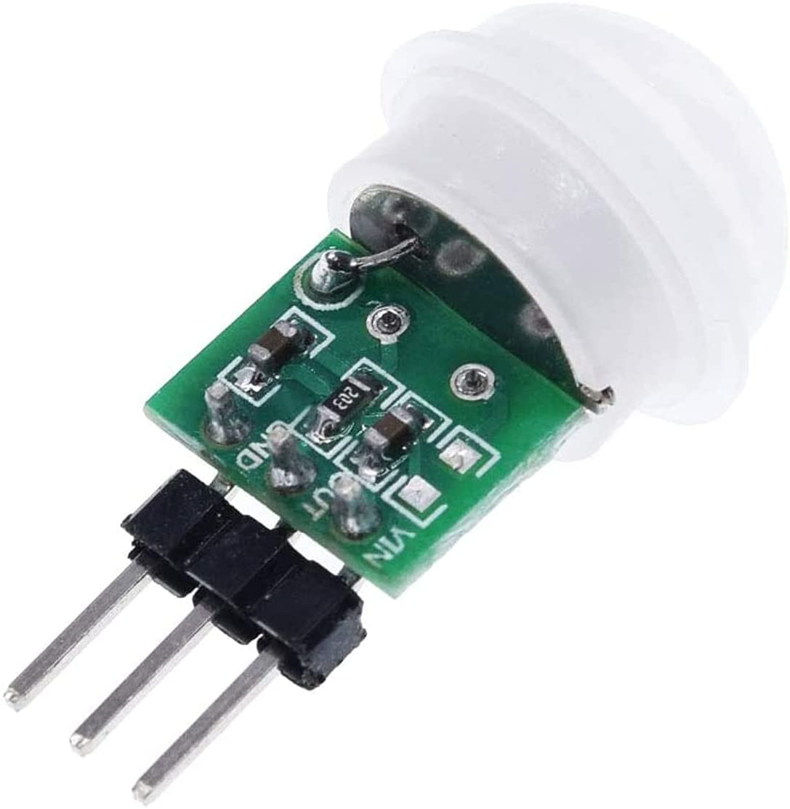
Sensor Development
PIR Sensor
Supplied with 0 to 3.6V
Outputs a digital signal
Time based operating frequency: 16kHz

Slide 17
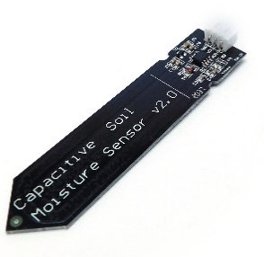
Sensor Development
Capacitive soil moisture sensor
Supplied with 3.3 to 5.5V
Outputs an analog signal
XH2.54-3P connectors
For calibration:
Set the value when the probe is exposed to the air to 0%RH”
Set the value when the probe is placed in a cup of water to 100%RH”

Slide 18
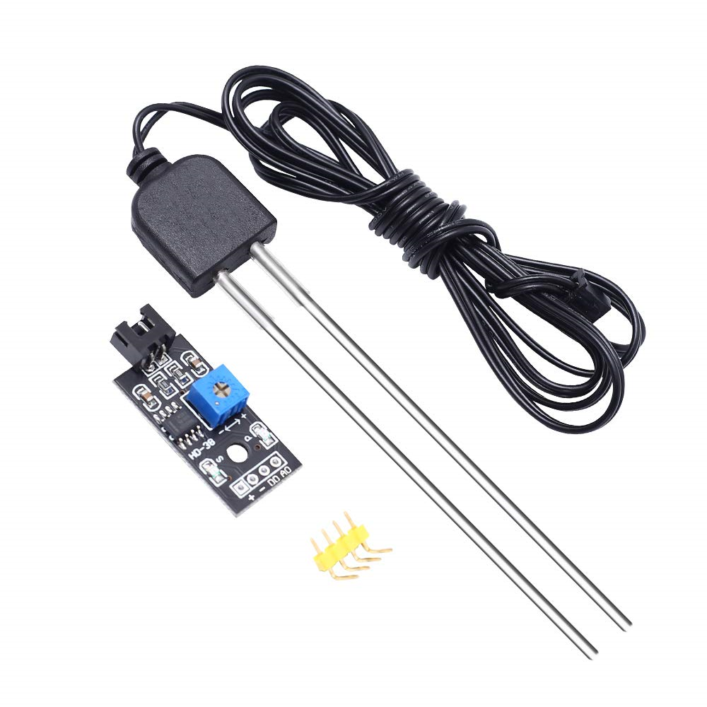
Sensor Development
Resistive soil moisture sensor
Supplied with 3.3 to 5.5V
Outputs an analog signal
XH2.54-3P connectors
For calibration:
Set the value when the probe is exposed to the air to 0%RH”
Set the value when the probe is placed in a cup of water to 100%RH”

Slide 19
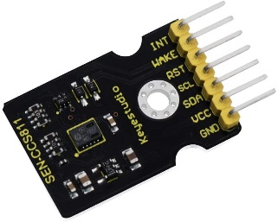
Sensor Development
Co2 air quality gas sensor module
Supplied with 3 to 5V
I2C communication
Frequency of I2C bus supported 100 kHz

Slide 20
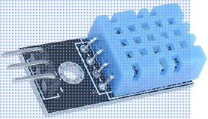
Sensor Development
DHT11 Temperature and Humidity Sensor
Sampled at a maximum rate of 1 second
Analog interface to Arduino

Slide 21
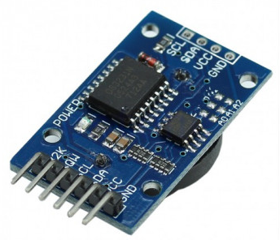
Sensor Development
Real Time Clock
I2C communication
Fast (400kHz) I2C interface
Comes with a 3V battery
Requires 1 time manual synchronization

Slide 22
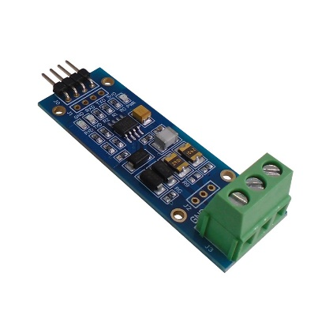
Sensor Development
RS485 to TTL board
Supplied with 5V
Transmit up to 2.5Mbps

Slide 23
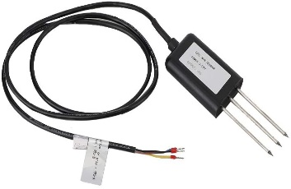
Sensor Development
Xinwoer soil NPK sensor
Supplied with 12 to 24V
RS485 communication
Variable baud rate: 2400/4800/9600
Can be used with multiple sensors in a 485 bus

Slide 24
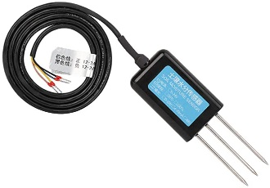
Sensor Development
Xinwoer soil PH sensor V2.0
Supplied with 12 to 24V
RS485 communication
Variable baud rate: 2400/4800/9600
Can be used with multiple sensors in a 485 bus

Slide 25
Sensor Node Development Testbed Status
Sensor | Status
Digital light intensity sensor | Function calls integrated into a SensorNode
PIR sensor | Function calls integrated into a SensorNode
Capacitive soil moisture sensor | REAPERLab SensorNode tested
Resistive soil moisture sensor | Function calls integrated into a SensorNode
Co2 air quality gas sensor module | Function calls integrated into a SensorNode
Temperature and humidity sensor | REAPERLab SensorNode tested
Real time clock | Function calls integrated into a SensorNode
RS485 to TTL board | Function calls are not implemented yet
RS485 to TTL board | Function calls are not implemented yet
Xinwoer soil PH sensor | Function calls are not implemented yet

Slide 26
SensorNode Firmware Structure
The firmware is organized into sections:
Initialization
*** used in comments of the code
Setup parameters, assign microcontroller resources
Setup
+++ used in comments of the code
Main loop
Function definitions
--- used in comments of the code
Interrupts are used to control timing and support sleep modes to reduce power consumption
Currently, sampling rate is arbitrary, chosen to support development and debugging. Probably will be slowed down for actual data collection

Slide 27
Firmware Flowchart

Slide 28
Communication to ThingSpeak™
Send single data read at a time using ThingSpeak™ Arduino library
Bulk update data to ThingSpeak™ using JSON format
Using variable string for message body format
Bulk update & Memory Optimization (in progress)
Using constants for the fixed part of the string
Using ArduinoJson library for handling JSON structure
Using fixed memory allocation, allowing to work on devices with very little RAM.
Splitting the post string ( body string) to multiple post strings

Slide 29
Future Capabilities
Optimize memory usage of the JSON string
Integrate LoRa wireless communication for increased range of outdoor testing
Add external SD card for local data buffering in case communication is lost
Optimize power consumption by using sleep mode
Phase 2 REAPERlab SensorNode
Development and field testing

Slide 30
Thank You
Acknowledgment:
This publication was made possible by AICC02-0505-190022 from the Qatar National Research Fund (a member of Qatar Foundation). The statements made herein are solely the responsibility of the authors.

